Slide 1
Image Stitching
Creating panoramas using homography computation

Slide 2
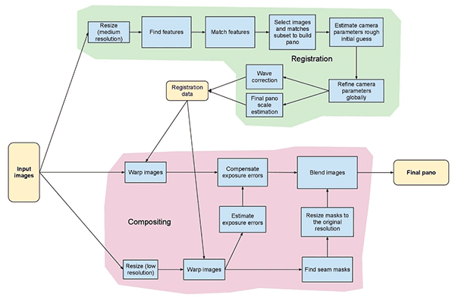
Panoramic Stitching Process

Slide 3
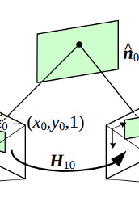
Methodologies
Homography Computation
Feature Matching:
Detected key points using SIFT or ORB algorithms.
Matched features between images to find correspondences.
Computing Homography Matrix:
Formulated a linear system from matched points.
Used Singular Value Decomposition (SVD) to solve Ax=b
Applied RANSAC algorithm to handle outliers and find the best HHH.

Slide 4
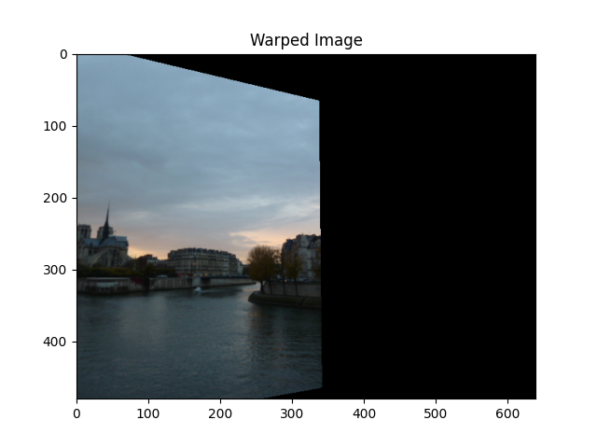
Methodologies
Image Warping
Inverse Mapping:
Calculated the inverse homography
Mapped destination pixels back to source image coordinates.
Bilinear Interpolation:
Estimated pixel values at non-integer coordinates.
Ensured smoothness and reduced artifacts in the warped image.

Slide 5
Results and Conclusion
Gained practical experience with homography and image warping.
Deepened knowledge of linear algebra applications in image processing.
The following are some results!

Slide 6
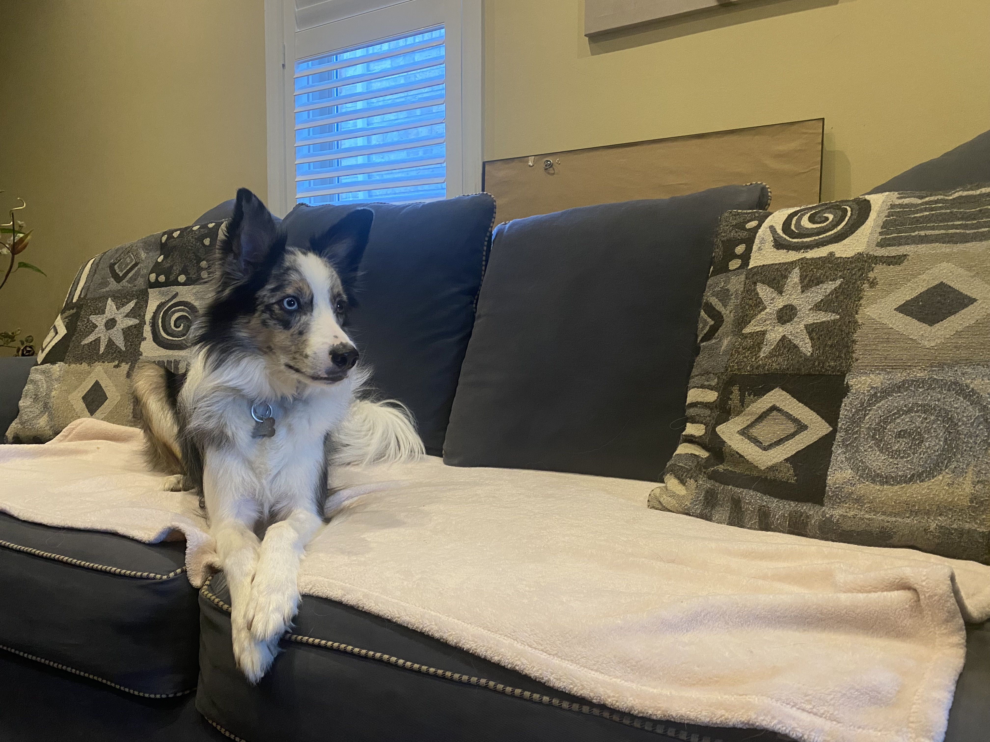
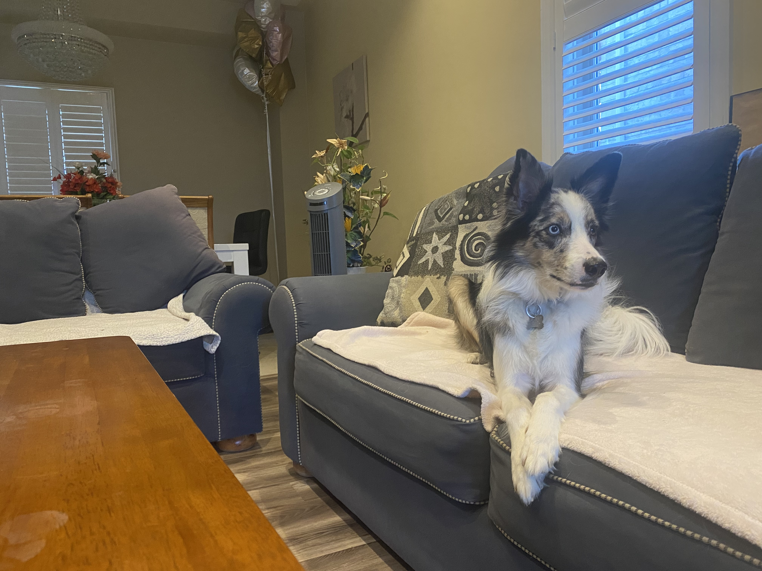
Exhibit 1

Slide 7
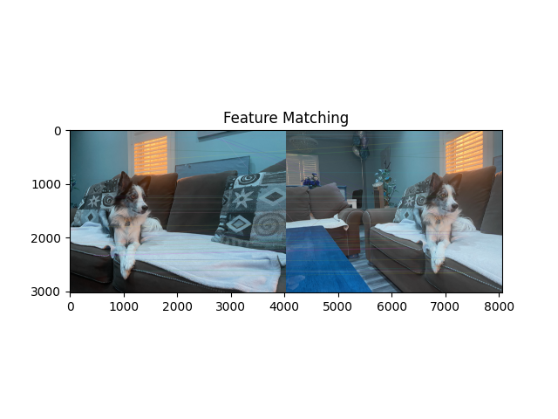
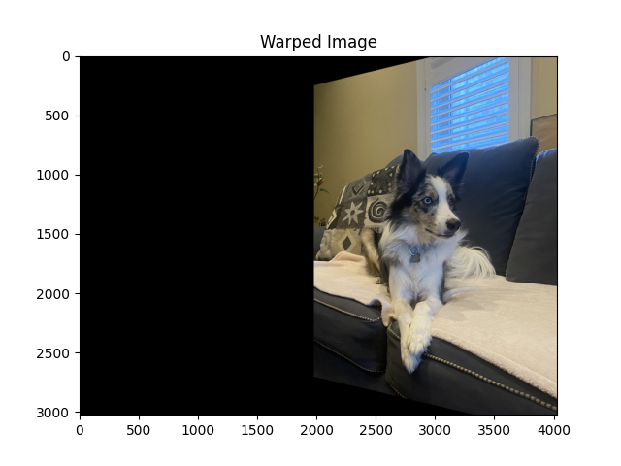
Exhibit 1

Slide 8
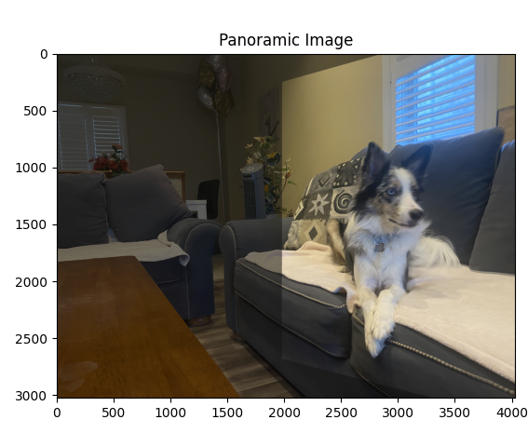
Exhibit 1
Notice: small blurs due to minor movements.

Slide 9
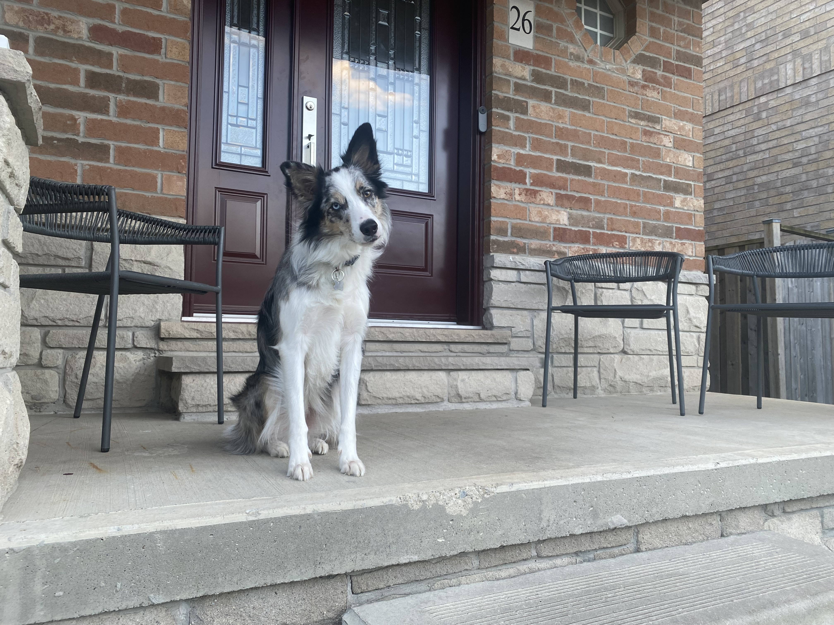
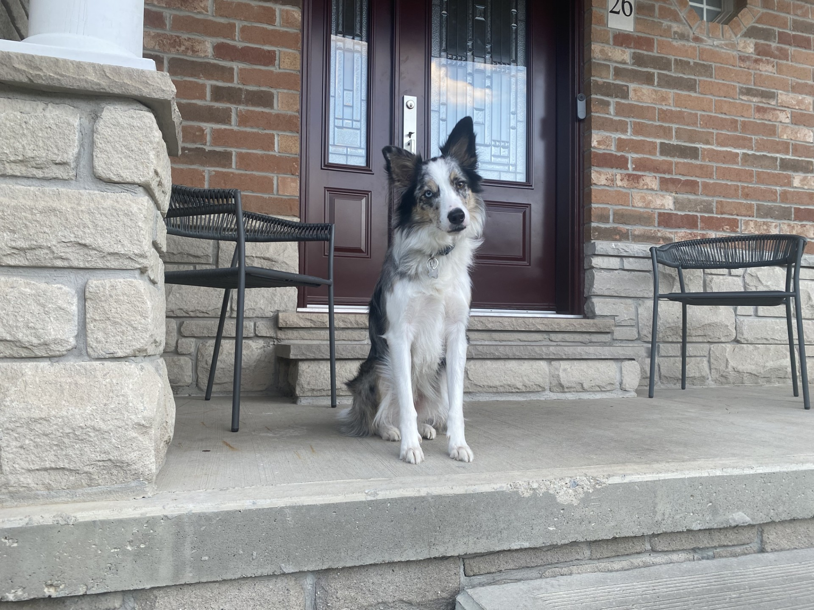
Exhibit 2

Slide 10
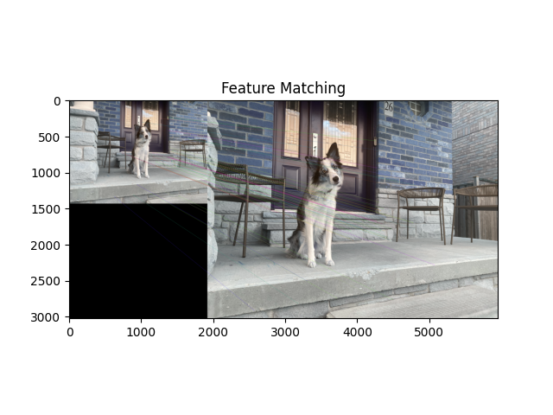
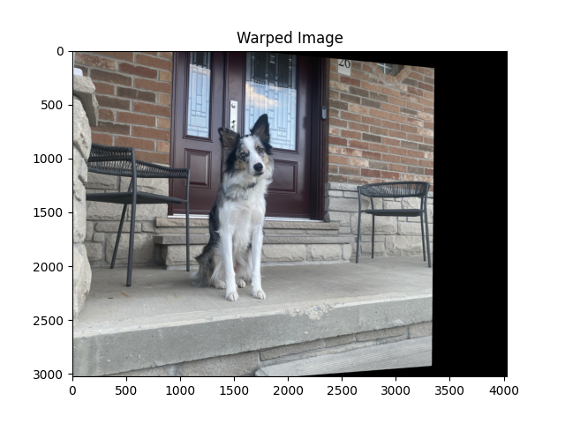
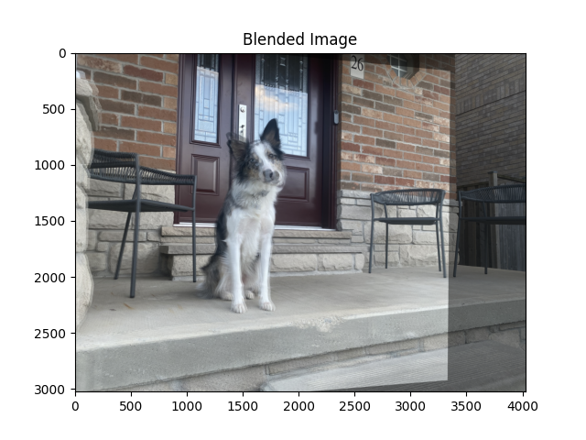
Exhibit 2

Slide 11
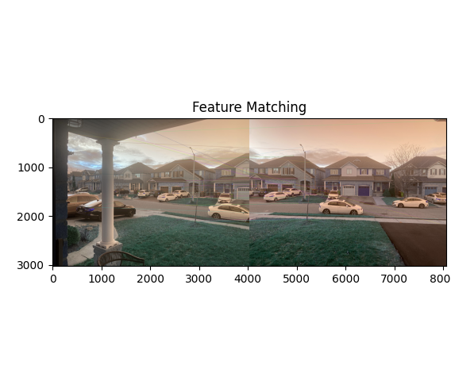
Exhibit 3
Trying 3 Static Images.

Slide 12
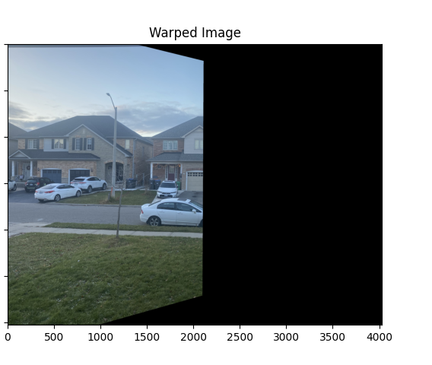
Exhibit 3
Warp needed for first two images.

Slide 13
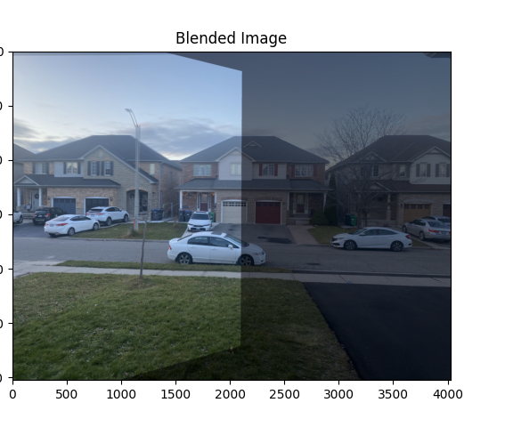
Exhibit 3
First Panorama

Slide 14
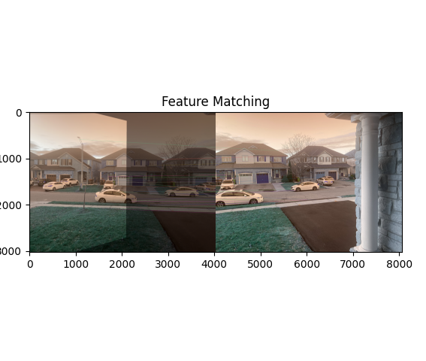
Exhibit 3
Feature Detection for Blended Image 1 and Image 2, with Image 3

Slide 15
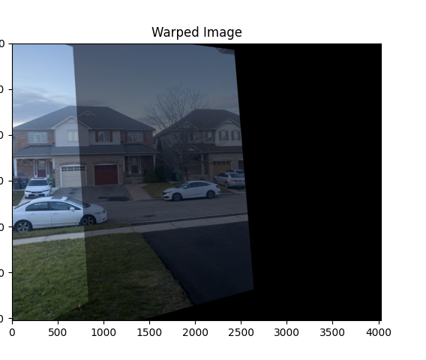
Exhibit 3
Image Warping needed.

Slide 16
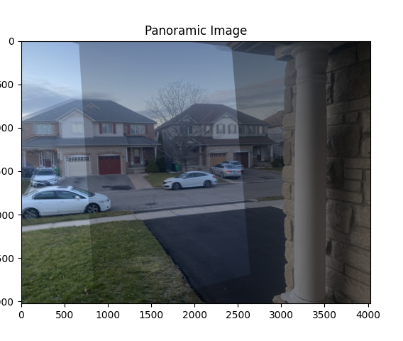
Exhibit 3
Final Panoramic

